Slide 1

Jordan, Michael, Jeremy, Adi, Liron

Slide 2
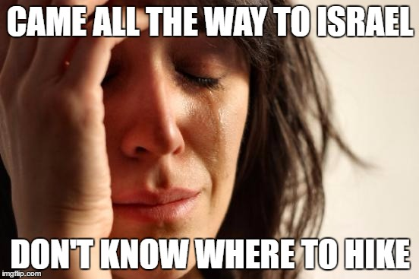
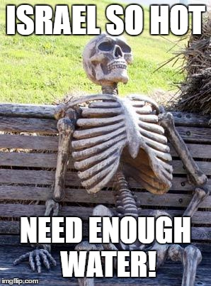
Problem

Slide 3
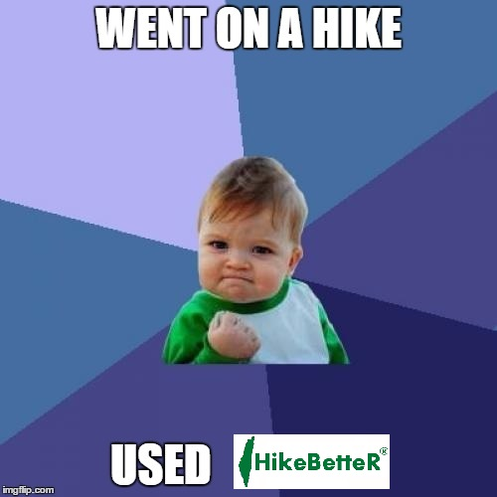
Solution

Slide 4
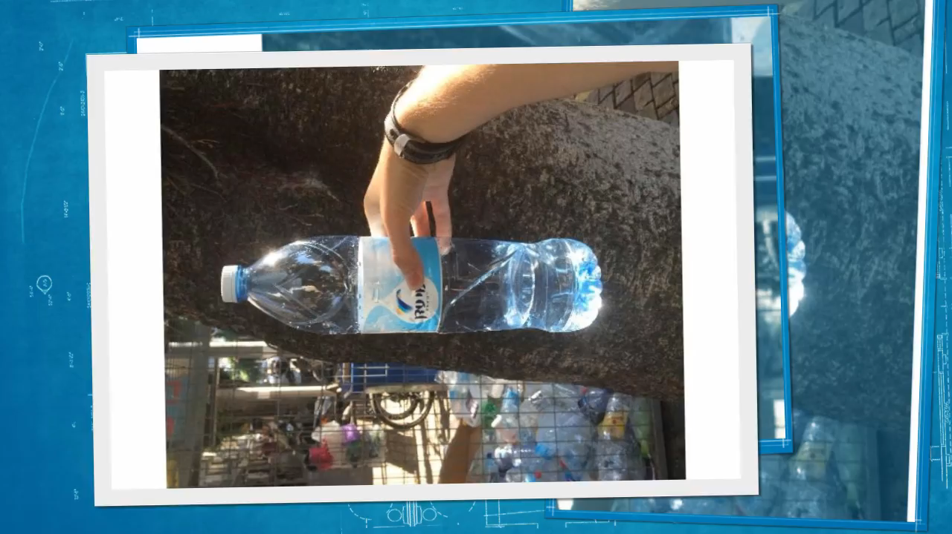
Water ID technology

Slide 5

Why Us?
Useful, original
Scalable to the global market
Monetization opportunities – targeted ads

